Slide 1


PLATFORM OVERVIEW
Visibility. Marketplace.
Member Rewards.
Service Directory
Find skilled artisans and professionals
Marketplace
Discover products and connect with sellers
A digital growth ecosystem for artisans, professionals, product sellers, institutions and small businesses.
Business Promotions
Give approved businesses public visibility
RPTCODE - Resource Palm T-code
rptcode.com
RPTCODE | Professional presentation

Slide 2
THE CHALLENGE
Great work often remains invisible.
Skill is not the problem. The challenge is being found, trusted and chosen.
Low discoverability
Trust gap
Many artisans and small businesses depend on word of mouth and cannot consistently reach new customers.
Customers struggle to verify providers, compare options and know who is reliable before making contact.
Costly promotion
Unpredictable sales
Paid advertising can be expensive, short-lived and difficult to sustain for a growing business.
Without steady visibility and customer traffic, income remains irregular even when the product or service is strong.
RPTCODE - Resource Palm T-code

Slide 3
THE OPPORTUNITY
One digital home for local commerce.
RPTCODE connects discovery, trusted contact paths, member tools and growth opportunities in one ecosystem.
Artisans
Product sellers
Skilled local providers
Marketplace visibility
Discover | Connect | Grow
Businesses
Customers
Public promotions
Trusted discovery
RPTCODE | Member-powered commerce

Slide 4
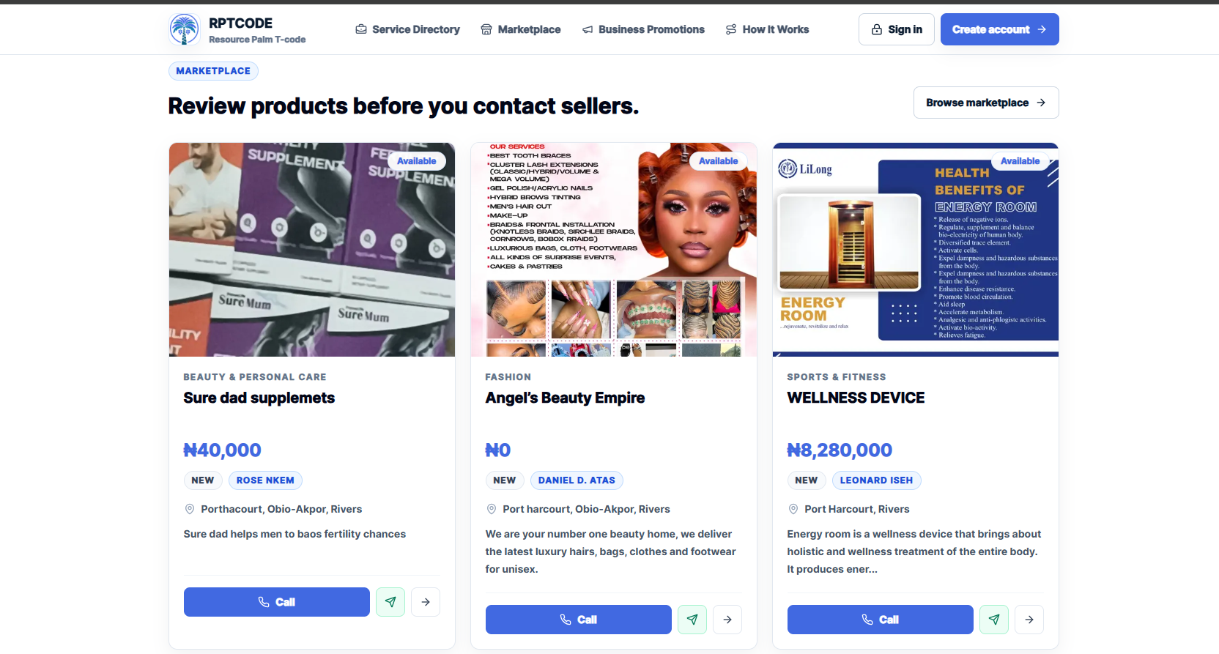
THE PLATFORM
What RPTCODE brings together
Three public discovery experiences supported by one member ecosystem.
Service Directory
Artisans and professionals can present their skills, location and contact paths.
Marketplace
Product sellers can showcase offers and connect directly with interested buyers.
Business Promotions
Businesses and institutions can build public visibility beyond word of mouth.
LIVE PRODUCT
Approved listings become public, searchable and directly contactable.
RPTCODE - Resource Palm T-code

Slide 5
MEMBER JOURNEY
From registration to growth
A simple path that supports both marketplace visibility and member rewards.
01
02
03
04
05
Join & verify
Activate membership
List or refer
Connect & grow
Track outcomes
Create an account and complete verification.
Unlock eligible member tools and account options.
Create an approved listing or share your referral link.
Reach customers or build a verified referral network.
Monitor wallet activity, rewards and progress in one dashboard.
RPTCODE - Resource Palm T-code

Slide 6
MEMBER VALUE
Built for visibility and growth
Members can participate through business discovery, referrals, or both.
Public discovery
Direct contact
Trust signals
Approved listings can reach people beyond the member’s immediate network.
Customers can call, message or visit the available business contact paths.
Verification and structured profiles help customers make informed choices.
Member patronage
Wallet visibility
Progression
A member-powered ecosystem encourages members to discover and support members.
Track rewards, transactions, withdrawals and supporting references.
Referral activity and qualifying leadership milestones create another growth path.
RPTCODE - Resource Palm T-code

Slide 7
MEMBER REWARDS
A second growth path: referral rewards
Members can earn from verified activations even when they are not selling a product or promoting a business.
DIRECT
EXTENDED
Referred member
Main Account
Each additional linked account
You share your link
₦5,000 each
₦15,000
Reward depth stops at level 2. No level 3 reward is introduced.
Illustrative programme explanation. Rewards require valid referrals, verified activations, eligibility and compliance with platform terms.

Slide 8
REFERRAL SCENARIOS
How the account-pack scenarios work
The direct reward is paid on the referred Main Account, with extended rewards on additional linked accounts.
1 ACCOUNT
3 ACCOUNTS
7 ACCOUNTS
Activation value
Activation value
Activation value
₦30,000
₦90,000
₦210,000
Referral reward
Referral reward
Referral reward
₦15,000
₦25,000
₦45,000
₦15,000 direct
₦15,000 + 2 × ₦5,000
₦15,000 + 6 × ₦5,000
Programme figures supplied by RPTCODE. Rewards are illustrative and are not guaranteed income.
RPTCODE - Resource Palm T-code

Slide 9
MAIN-ACCOUNT SCENARIOS
How multiple activations can reward the Main Account
Illustrative example: the Main Account earns ₦15,000 for each additional activated account in the pack.
2 ACCOUNTS
3 ACCOUNTS
Main-account reward
Main-account reward
₦15,000
₦30,000
1 × ₦15,000
2 × ₦15,000
4 ACCOUNTS
7 ACCOUNTS
Main-account reward
Main-account reward
₦45,000
₦90,000
3 × ₦15,000
6 × ₦15,000
Illustrative scenario supplied for RPTCODE programme communication. Rewards remain subject to verified activity, eligibility, platform terms and approval.
RPTCODE - Resource Palm T-code

Slide 10
ILLUSTRATIVE SCALE
What 10 successful referrals can look like
₦450,000
A simple illustration of gross referral rewards across the three account-pack scenarios.
₦250,000
Illustrative only - not guaranteed
Actual rewards depend on qualified activity and verified activations.
₦150,000
10 × 1 account
10 × 3 accounts
10 × 7 accounts
10 × ₦15,000
10 × ₦25,000
10 × ₦45,000
Illustrative gross referral rewards. Earnings are not guaranteed and may vary by member activity and programme compliance.
RPTCODE - Resource Palm T-code

Slide 11
LEADERSHIP
Progress that can unlock staged rewards
The RPTCODE leadership schedule recognises qualifying progress across seven stages.
STAGE 7
STAGE 6
STAGE 5
STAGE 4
STAGE 3
STAGE 2
STAGE 1
₦50K
₦200K
₦1M
₦5M
₦25M
₦125M
₦625M
Qualification criteria and award approval apply at every stage.
Leadership amounts are based on the RPTCODE programme schedule supplied for this presentation. Awards are subject to qualification and approval.

Slide 12
PAYOUT & CONTROL
Rewards move through a controlled wallet flow
Every approved payout follows a traceable process from credit to bank transfer.
Wallet credit
Withdrawal request
Admin review
Bank payout
A valid reward is linked to a wallet transaction.
The member requests a payout from available balance.
Bank details, amount, fee and risk checks are reviewed.
Approved payouts are processed to the member’s bank.
Approved payouts: 0-24 hours, subject to review and bank processing times.
RPTCODE - Resource Palm T-code

Slide 13
WHO IT SERVES
Designed for people building real value
RPTCODE supports participants who want visibility, customer access, network growth, or a combination of all three.
Artisans
Professionals
Product sellers
Tailors, technicians, beauty professionals, builders and skilled trades.
Consultants, caregivers, educators, trainers and service providers.
Retailers, manufacturers, online vendors and local merchants.
Small businesses
Institutions
Community builders
Growing enterprises seeking public visibility and direct customer contact.
Schools, training centres, organisations and community services.
Members who grow through referrals, mentorship and leadership progress.
Participate through visibility, referrals, or both.

Slide 14
WHY RPTCODE
More than a marketplace
RPTCODE combines public discovery with member tools, rewards and progression.
A typical online listing
The RPTCODE growth ecosystem
One public profile or advert
Service directory, marketplace and promotions
Visibility depends mainly on traffic
Direct customer contact and public discovery
Separate tools for rewards and progress
Wallet, referral rewards and leadership progress
Limited community participation
Member-powered commerce and network growth
MARKETPLACE + MORE
RPTCODE - Resource Palm T-code

Slide 15
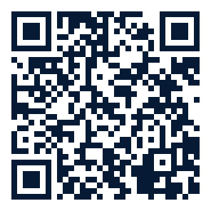
Get visible. Build your network.
Grow with RPTCODE.
Start here
Choose your growth path: showcase what you do, share your referral link, or combine both.
1. Create your account
2. Activate and verify
rptcode.com
3. List, refer and grow
Create an account and explore the marketplace.
Rewards and leadership figures are subject to verified activity, qualification, eligibility, platform terms and approval. This presentation does not guarantee income.
RPTCODE | Visibility. Marketplace. Member Rewards.

